Slide 1
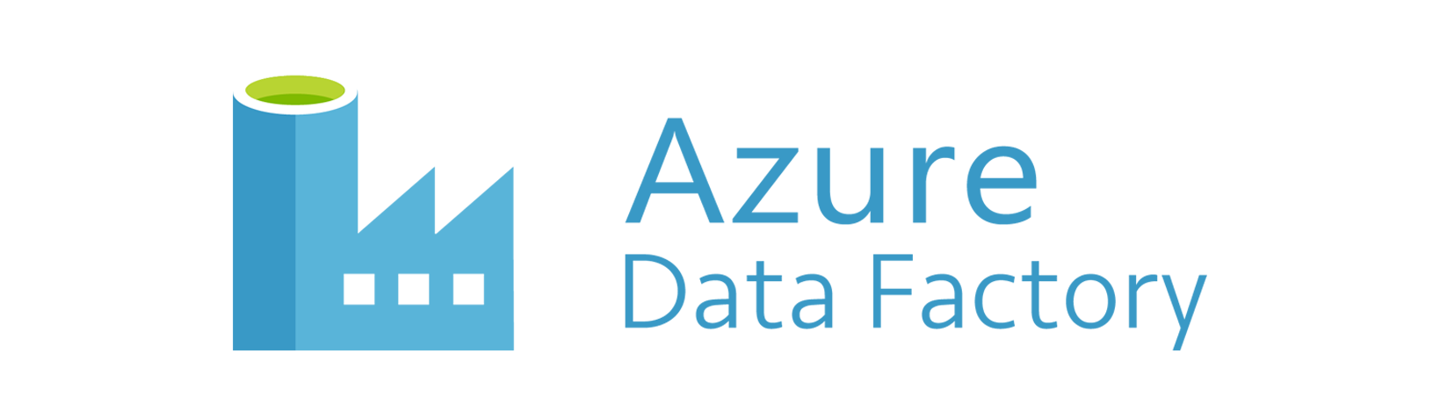


Azure user group Norway
virtual lunch meeting
Harun Raseed Basheer
Senior Consultant
Hitachi Solutions
LinkedIn : https://www.linkedin.com/in/harunraseed/
Blog : https://medium.com/@harun.raseed093

Slide 2
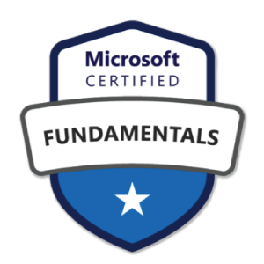
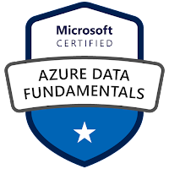

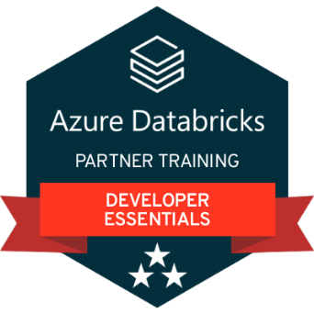
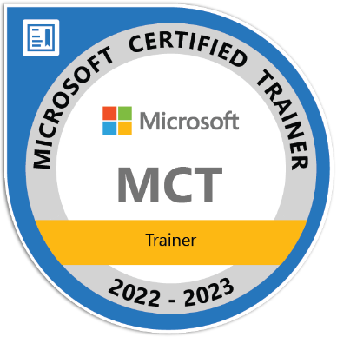
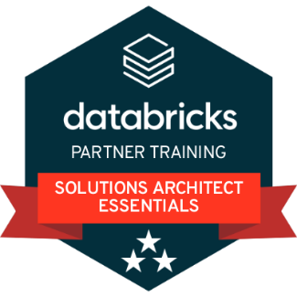
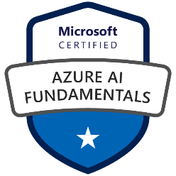


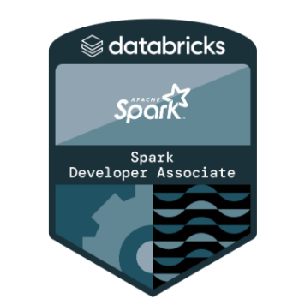
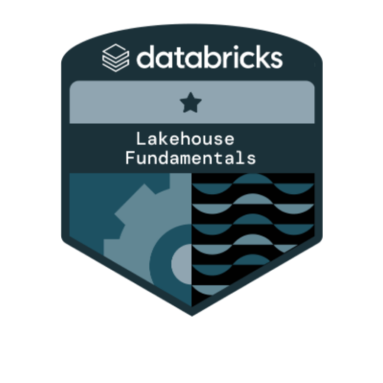
Harun Raseed Basheer

Slide 3
Introduction To Azure Data Factory
Introduction To Azure Data Factory
ADF Components
Configuring ADF for Copying Data
Scheduling a Pipeline
Transforming data
Copying Data from Different Sources

Slide 4
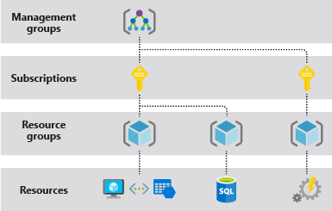
Azure Cloud Subscription & Resources.

Slide 5
AZURE Cloud Subscription & Resources
What is Azure Subscription?
A Windows Azure subscription grants you access to Windows Azure services and to the Windows Azure Platform Management Portal.
What is Resource Group?
Resource Group is a container that holds related resources for an Azure solution. The resource group includes those resources that you want to manage as a group. You decide how to allocate resources to resource groups based on what makes the most sense for your organization.
What is Resource?
Resource is a manageable item that is available through Azure. Virtual machines, storage accounts, web apps, databases, and virtual networks are examples of resources.
What is Azure Data Factory?
It is a cloud-based data integration service that allows you to create data-driven workflows in the cloud for orchestrating and automating data movement and data transformation.

Slide 6
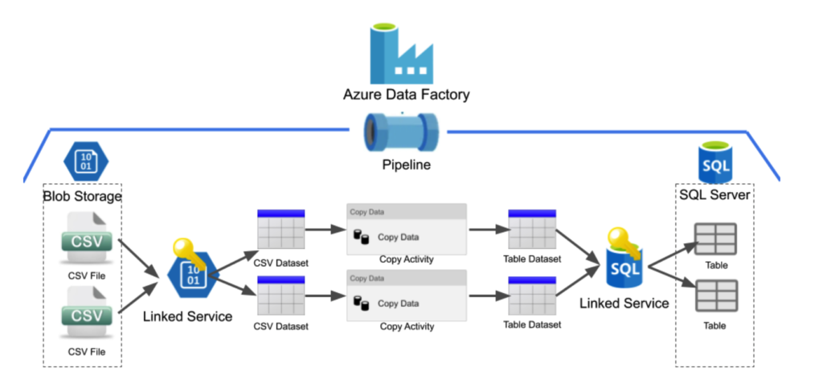
ADF Architecture

Slide 7
ADF V2 Components
Azure Data Factory is composed of the below key components. These components work together to provide the platform on which you can compose data-driven workflows with steps to move and transform data.
Pipelines
Activities
Datasets
Linked Services
Integration Runtime
Triggers
Data Flow

Slide 8
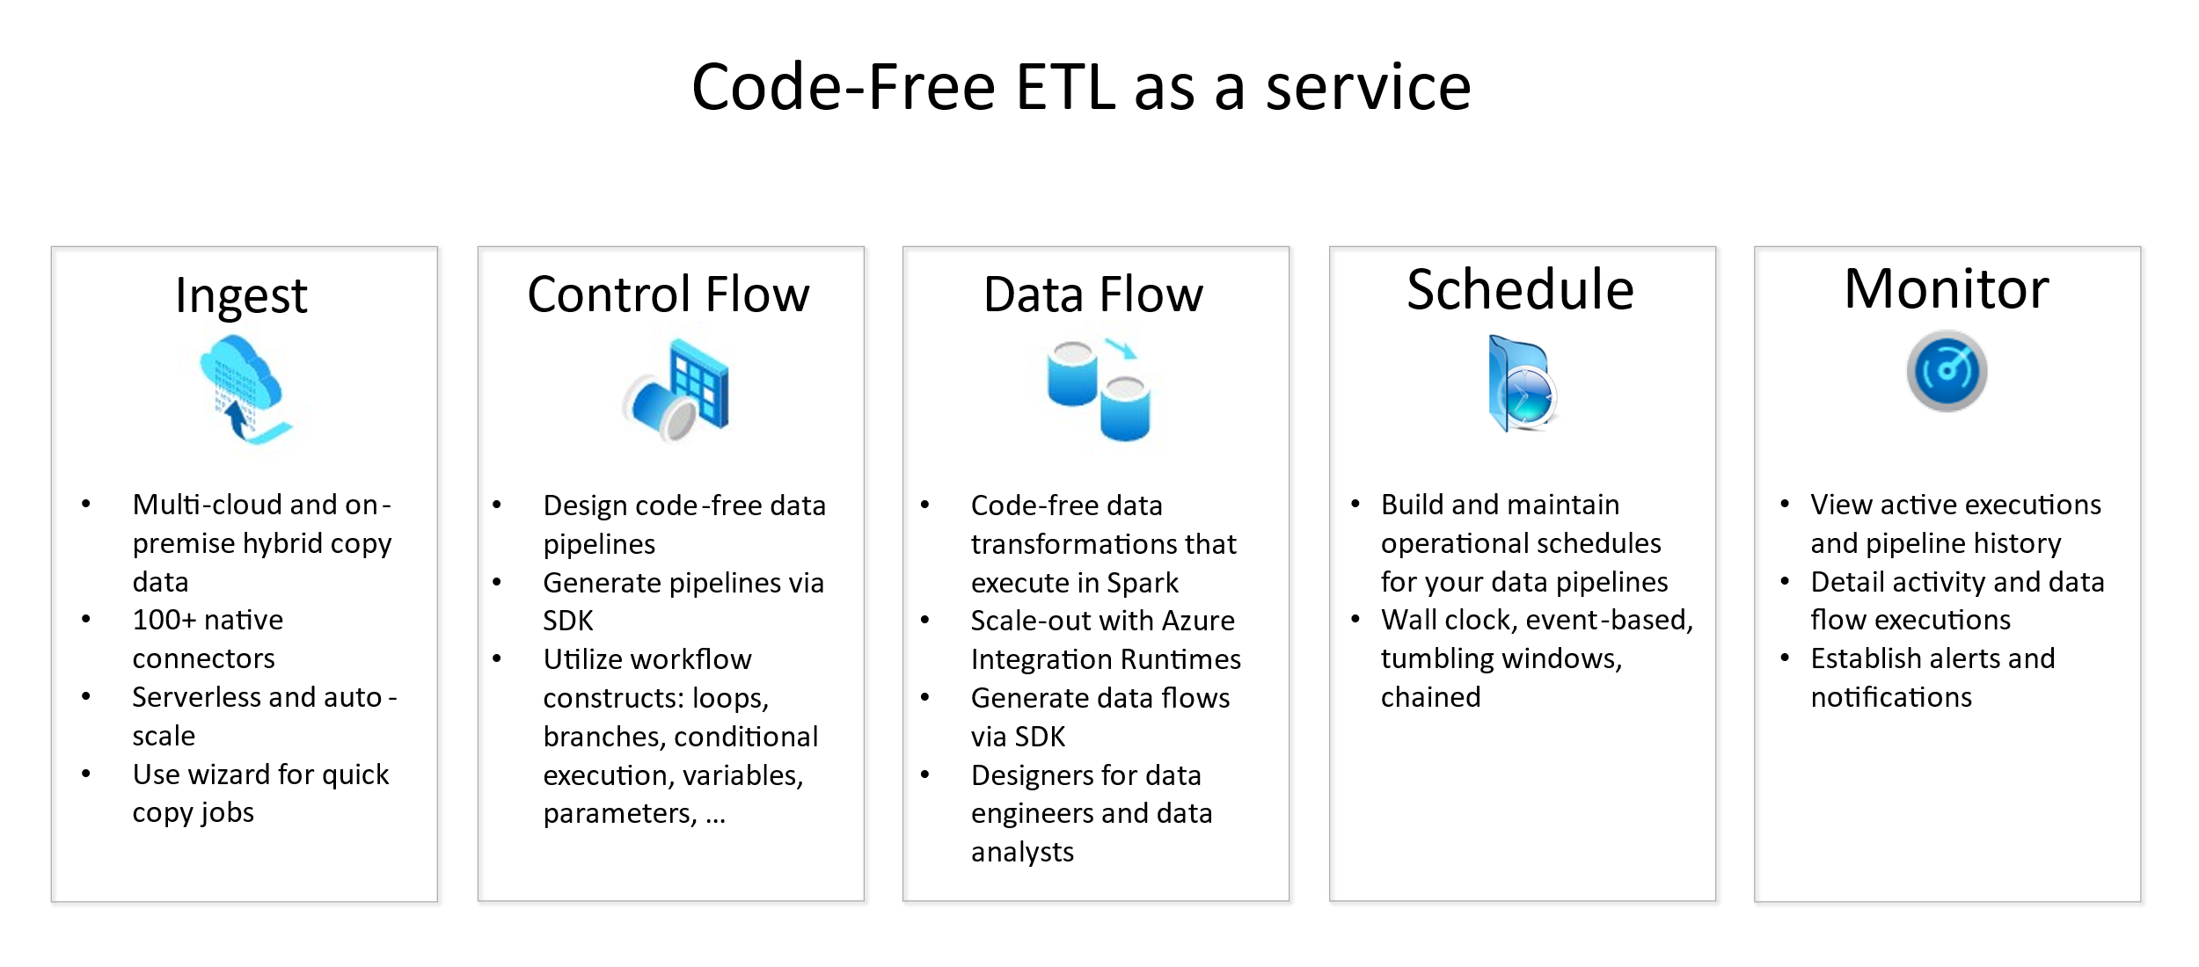

Slide 9
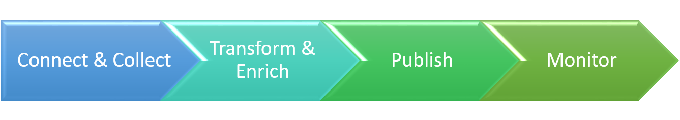
AZURE ADF V2 COMPONENTS FLOW
Big data requires service that can orchestrate and operationalize processes to refine these enormous stores of raw data into actionable business insights. Azure Data Factory is a managed cloud service that's built for these complex hybrid extract-transform-load (ETL), extract-load-transform (ELT), and data integration projects.
The pipelines (data-driven workflows) in Azure Data Factory typically perform the following four steps:

Slide 10

ADF V2 Components Relation
Data Factory supports three types of activities:
data movement activities
data transformation activities
control activities
An activity can take zero or more input datasets and produce one or more output datasets. The following diagram shows the relationship between pipeline, activity, and dataset in Data Factory:

Slide 11
ADF V2 IR Types
What is Integration Runtime?
The Integration Runtime (IR) is the compute infrastructure used by Azure Data Factory to provide the data integration capabilities across different network environments like
Data Flow, Data Movement, Activity Dispatch and SSIS Package Execution.
Integration runtime types
Data Factory offers three types of Integration Runtime, and you should choose the type that best serve the data integration capabilities and network environment needs you are looking for.
Azure
Self-hosted
Azure-SSIS
IR Use Cases
Copying between two cloud data source and targets
Copying between a cloud data source and a data source in private network
Copying between two data sources in private network

Slide 12
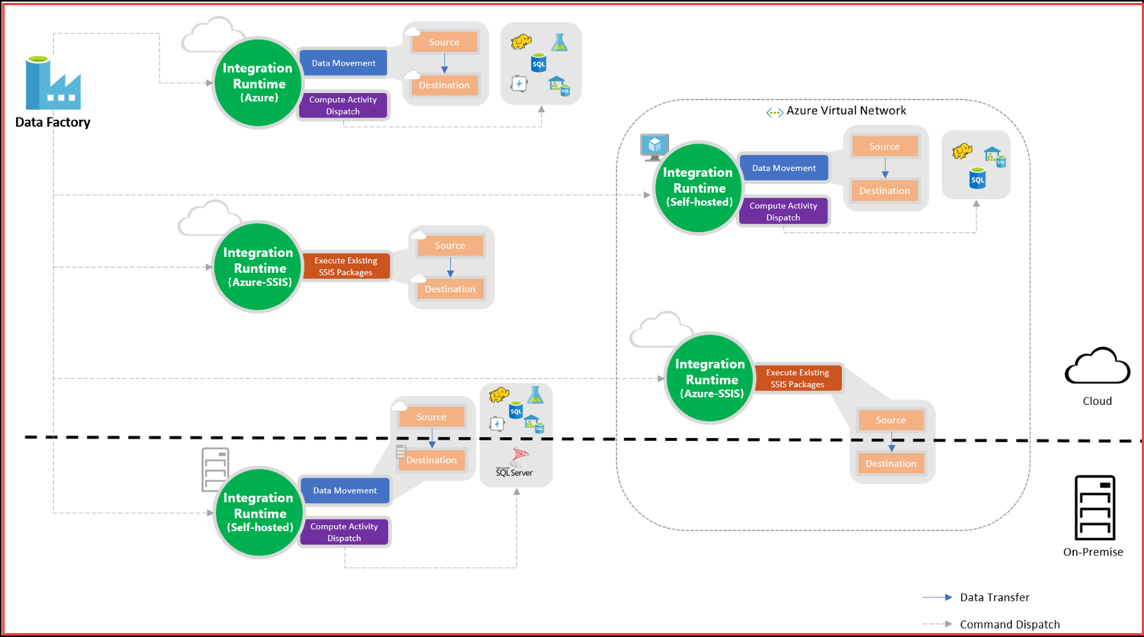

Slide 13
AZURE ADF V2 Features
1) Execute SSIS Package
2) Integration Runtime (IR) – (Azure, Self – Hosted, Azure-SSIS)
3) Control Flow (branching, looping and conditional processing)Linked Services
4) Linked Services
5) Triggers For Pipeline Scheduling
6) OMS Monitoring (Operational Monitoring Suite)
7) Data Flow
8) Expressions and Functions
9) Parameterized Pipelines
10) on-demand Spark linked service
11) Support for more data stores
12) Invoking a pipeline from another pipeline ( Execute Pipeline Activity)
13) Custom state passing (current activity getting previous activity output
@activity('NameofPreviousActivity').output.value)
14) Incremental Load Flow (Delta Load Flow – based on watermark )
15) V2 Supports to execute Custom Activity for .Net script or executable.
16) Git Repository Integration.
17) ARM Templates for deploying Azure ADF to different environments
18) Key Vault Integration
19) Scale-out with on-demand processing power
20) Debugging Pipelines to identify errors and view the data view.
21) System Variables ( @pipeline().DataFactory, @trigger().ScheduleTime)
22) Demo COPY Activity (Dynamically Creation Pipe lines, data sets)

Slide 14





Thank You
https://www.linkedin.com/in/harunraseed/
https://medium.com/@harun.raseed093
https://www.c-sharpcorner.com/members/harunraseed-basheer

